Slide 1
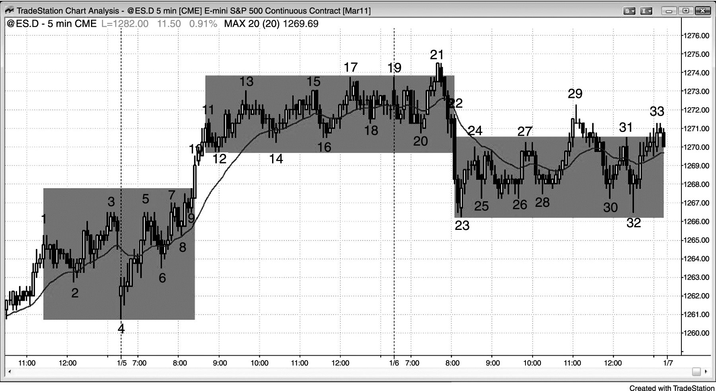
FIGURE 22.1 Trending Trading Range Days

Slide 2
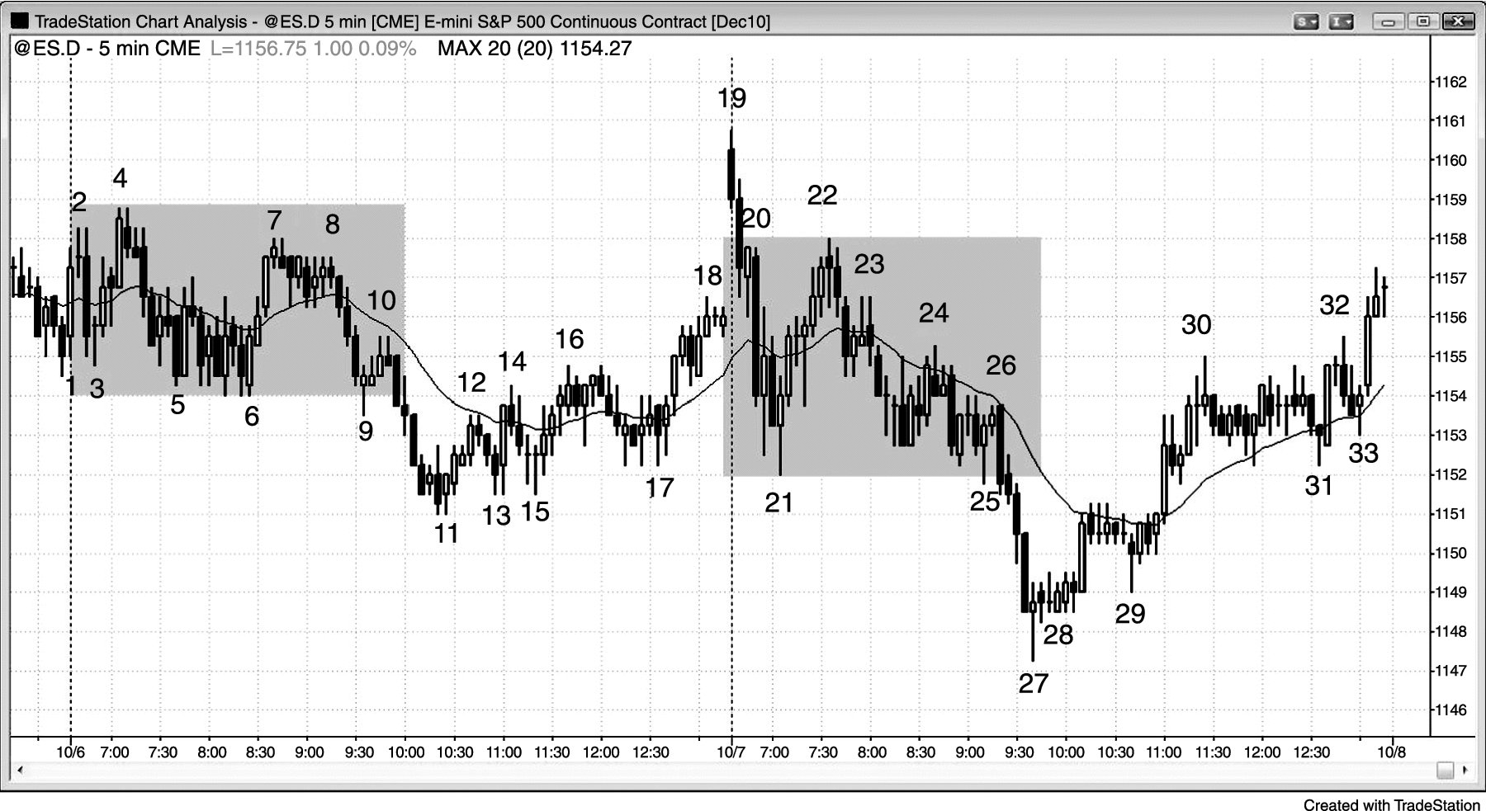
FIGURE 22.2 Initial Trading Range Is About Half of the Average Daily Range

Slide 3
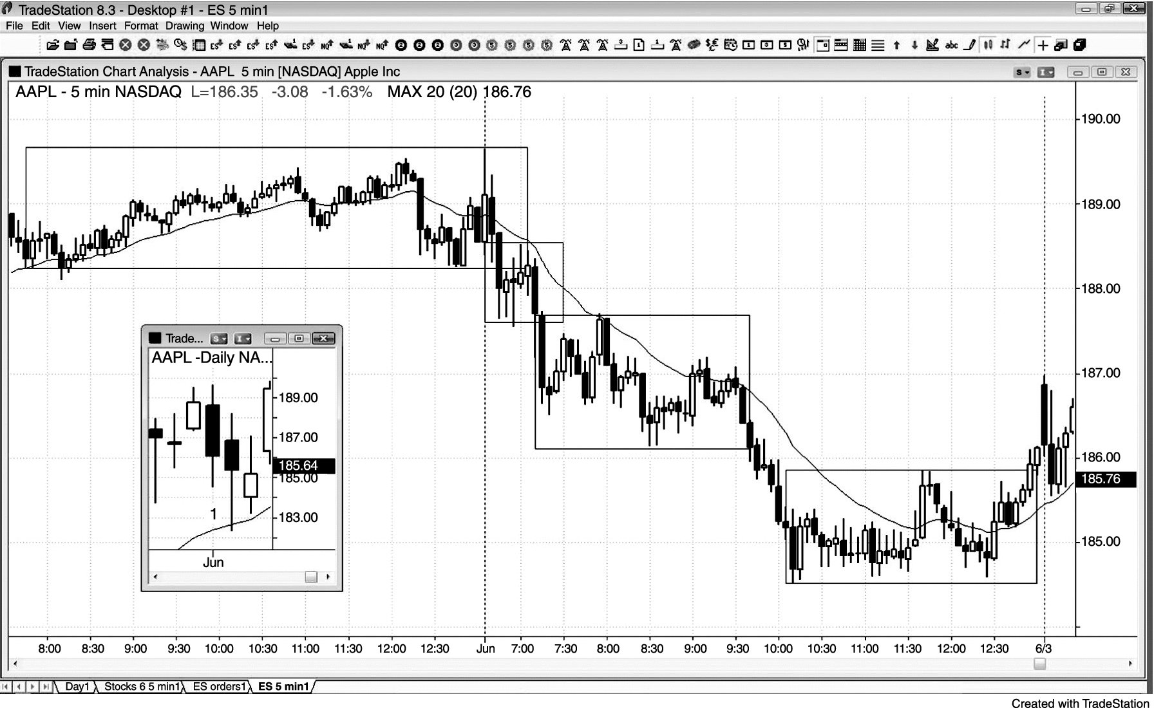
FIGURE 22.3 Trending Trading Ranges Create a Trend

Slide 4
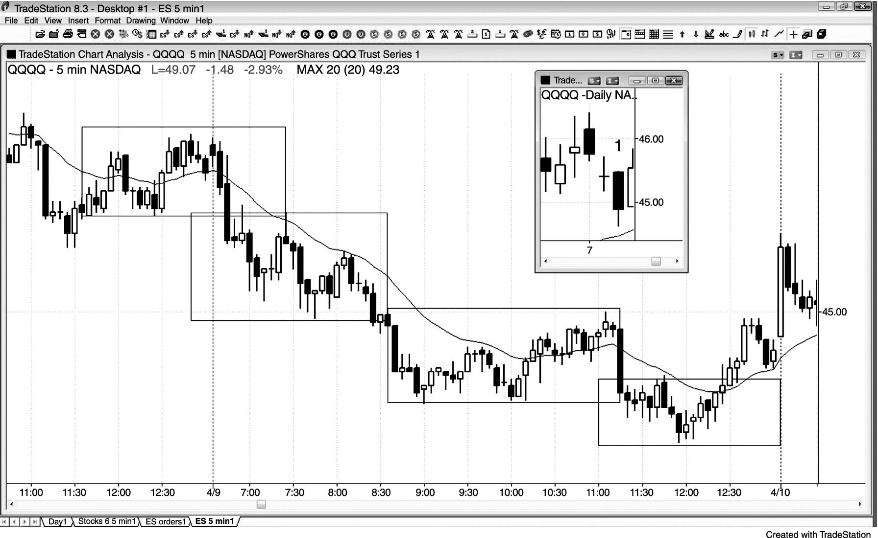
FIGURE 22.4 The First Trading Range Can Form Yesterday

Slide 5
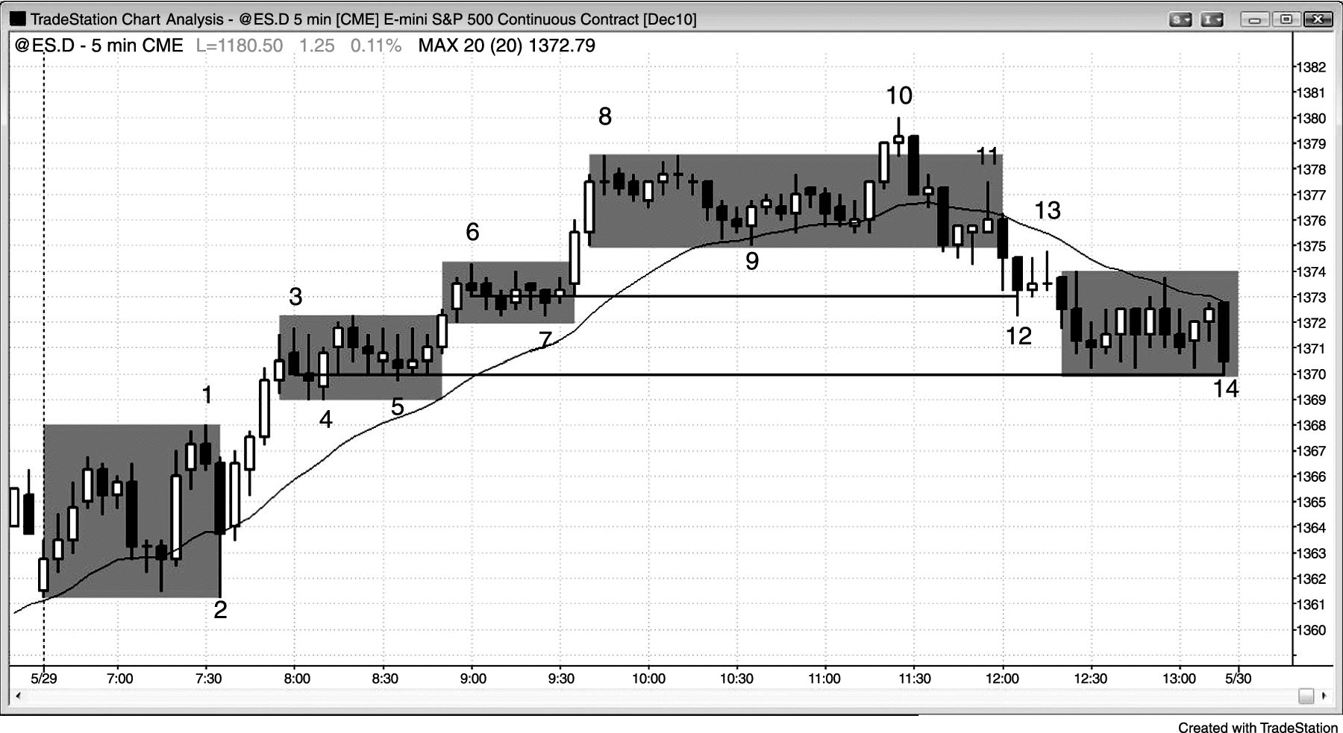
FIGURE 22.5 Trading Ranges Separated by Breakouts

Slide 6
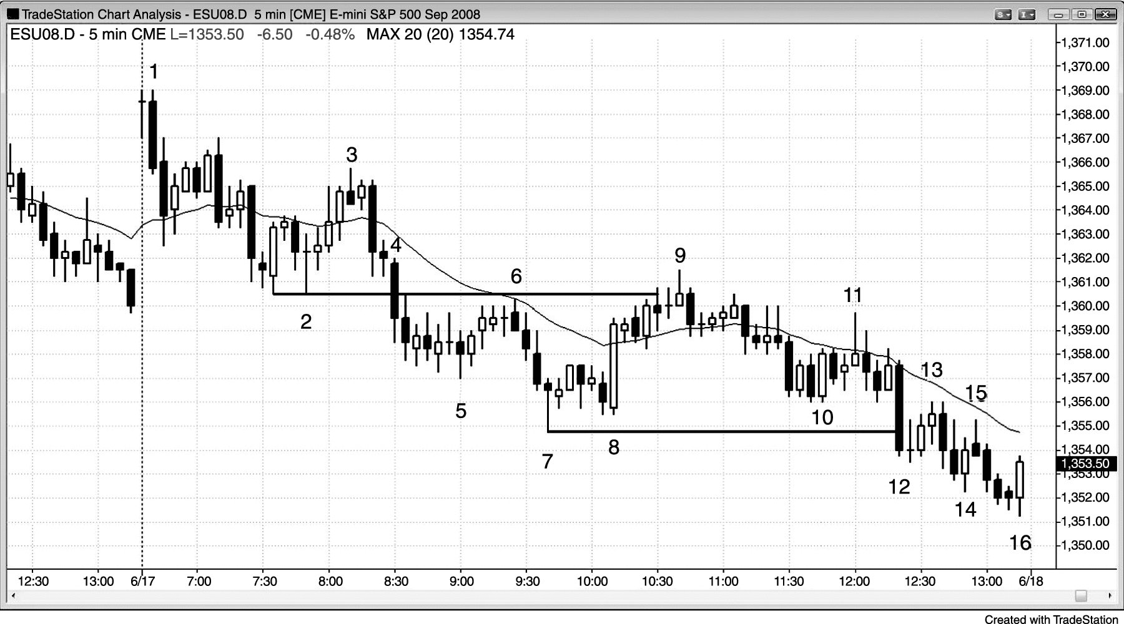
FIGURE 22.6 Two-Sided Trading in a Trend Day

Slide 7
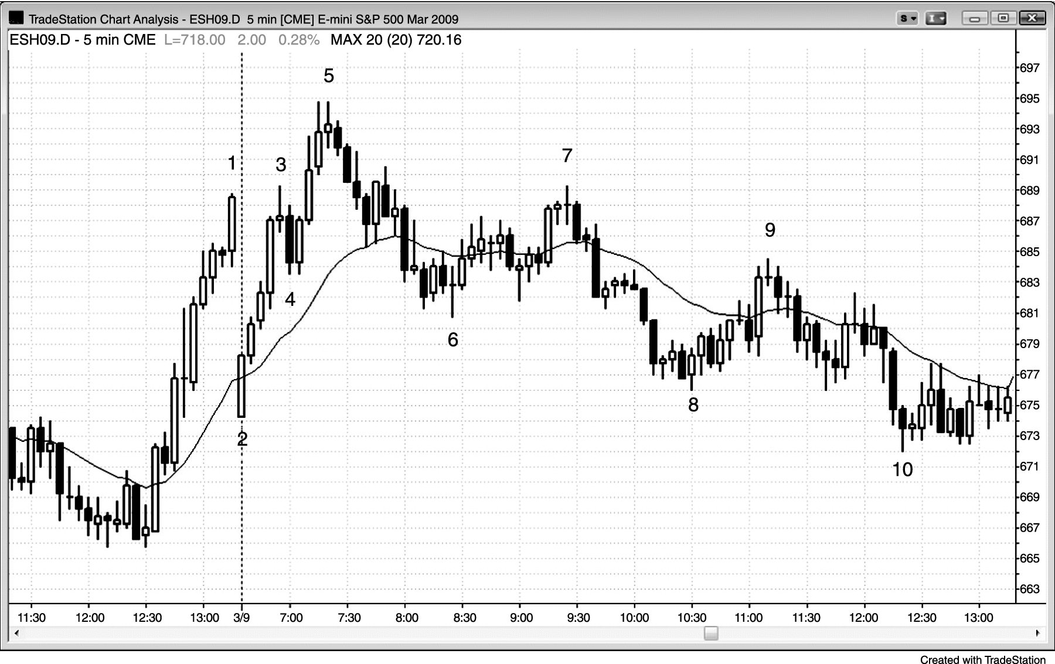
FIGURE 22.7 A Trend Starting after the First Hour Is Often Weak

Slide 8
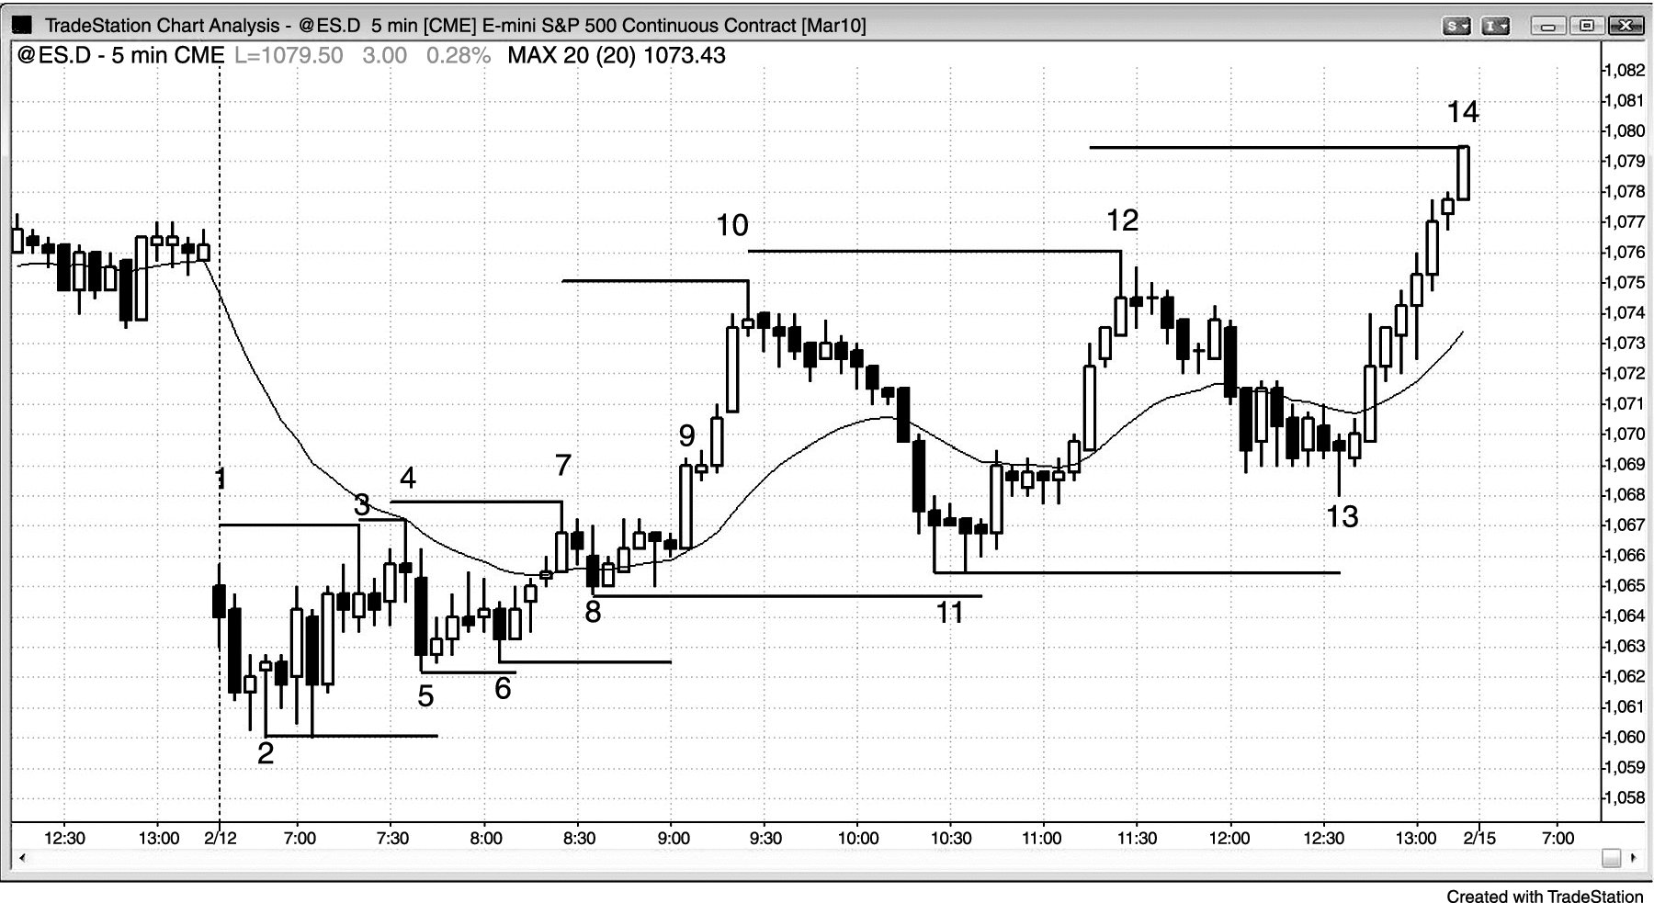
FIGURE 22.8 Initial Trading Range Often Presages Another Trading Range

Slide 9
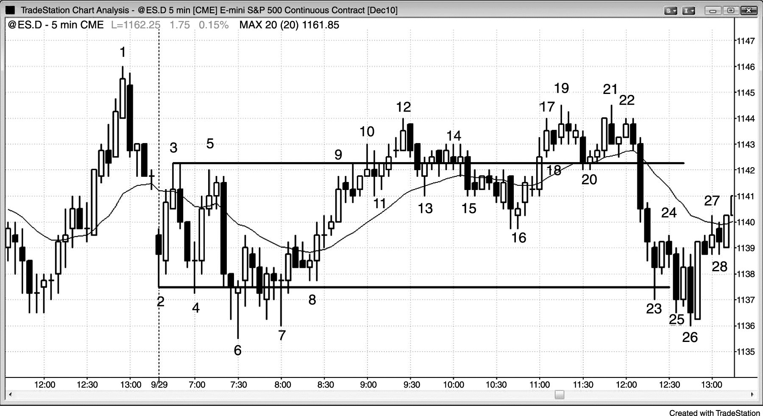
FIGURE 22.9 An Initial Trading Range Can Be Followed by a Trading Range Day

Slide 10
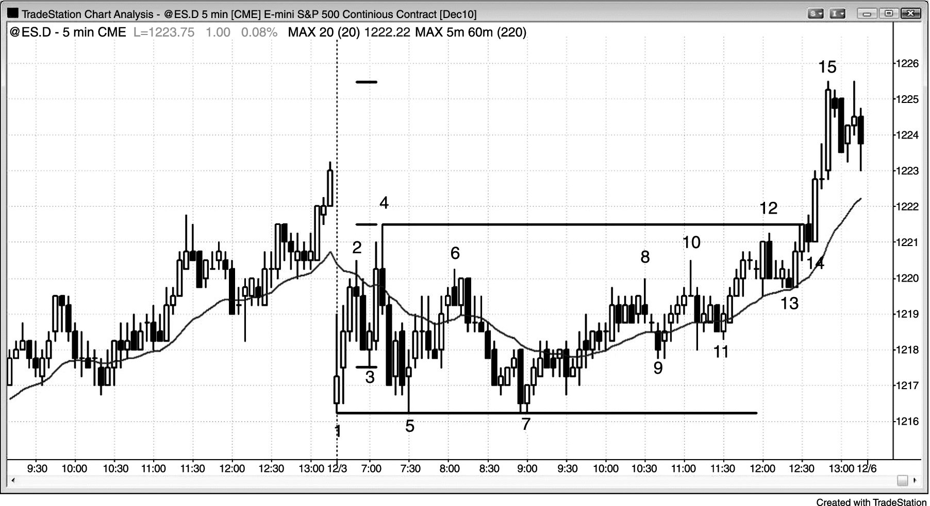
FIGURE 22.10 Late Breakout

